Slide 1
Data Science – Inferential Statistics

Slide 2
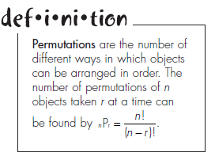
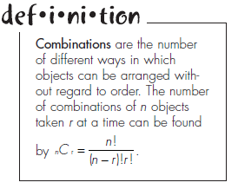
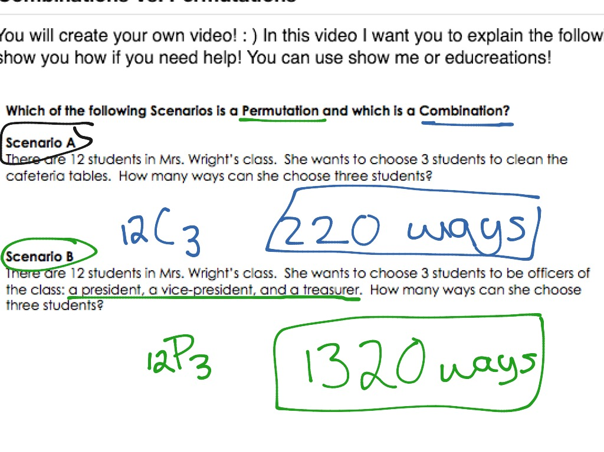
Permutations and Combinations
Permutations are the number of different ways in which objects can be arranged in order. In a permutation, each item appears only once. The number of permutations of n distinct objects is n! (expressed as n factorial)
As an example, there are six permutations for the numbers 1, 2, and 3, as shown here: 123, 132, 213, 231, 312, 321
Combinations are similar to permutations, except that the order of the objects is not important.

Slide 3
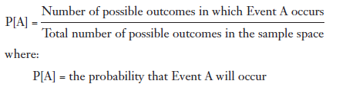
Probability
The topic of probability acts as a critical link between descriptive and inferential statistics
Experiment: The process of measuring or observing an activity for the purpose of collecting data. An example is rolling a pair of dice.
Outcome: A particular result of an experiment. An example is rolling a pair of threes with the dice.
Sample space: All the possible outcomes of the experiment. The sample space for sum of dice experiment is the numbers {2, 3, 4, 5, 6, 7, 8, 9, 10, 11, and 12}. Statistics people like to put {} around the sample space values.
Event: One or more outcomes that are of interest for the experiment and which is/are a subset of the sample space. An example event is getting a sum <=4 with two dice.

Slide 4
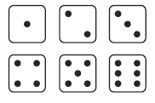
Probability
“Rules and regulations” that govern probability theory:
If P[A] = 1, then Event A must occur with certainty.
If P[A] = 0, then Event A will not occur with certainty
The probability of Event A must be between 0 and 1.
The sum of all the probabilities for the events in the sample space must be equal to 1. For example, if the experiment is flipping a coin with Event A = heads and Event B = tails, then A and B represent the entire sample space. We also know that P[A] + P[B] = 0.5 + 0.5 = 1.
The complement to Event A is defined as all the outcomes in the sample space that are not part of Event A and is denoted as A’. Using this definition, we can state the following: P[A] + P[A’] = 1 or P[A] = 1 – P[A’].

Slide 5
Conditional Probability
Conditional probability is defined as the probability of Event A knowing that Event B has already occurred.
Conditional probabilities are also known as posterior probabilities.
Events A and B are independent of one another if: P[A/B] = P[A]
An example of 2 independent events is the outcome of rolling two dice:
Event A: Roll the number 4 on the first of two dice.
Event B: Roll the number 6 on the second of two dice.
For two independent events, the multiplication rule of Probability states the following: P[A and B] = P[A] × P[B].
# see code example

Slide 6
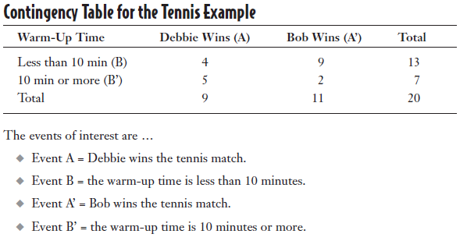
Conditional Probability
If Events A and B are said to be dependent events. If P[A/B] != P[A]
If the two events are dependent, the multiplication rule becomes: P[A and B] = P[A/B] × P[B]
# see code example

Slide 7
Conditional Probability
Two events are considered to be mutually exclusive if they cannot occur at the same time during the experiment.
For example, suppose my experiment is to roll a single die and my events of interest are as follows: Event A: Roll a 1. Event B: Roll a 2.
Addition rule of probabilities
For mutually exclusive events, the addition rule states that P[A or B] = P[A] + P[B].
If the events are not mutually exclusive like in the tennis example earlier, the addition rule becomes P[A or B] = P[A] + P[B] – P[A and B].
The logic behind subtracting P[A and B] in the addition rule is to avoid double counting.
# see code example

Slide 8
Probability Distributions - Binomial
A binomial experiment has the following characteristics:
The experiment consists of a fixed number of trials denoted by n;
Each trial has only two possible outcomes, a success or a failure;
The probability of success and the probability of failure are constant throughout the experiment;
Each trial is independent of any other trial in the experiment.
Examples :
Testing whether a part is defective after it has been manufactured
Observing the number of correct responses in a multiple-choice exam
The binomial probability distribution allows us to calculate the probability (p) of a specific number of successes (k) for a certain number of trials (n)
Random Variables
https://www.mathsisfun.com/data/random-variables.html

Slide 9
Probability Distributions – Poisson distribution
A Poisson process counts the number of occurrences of an event over a period of time, area, distance, or any other type of measurement.
A Poisson process has the following characteristics:
The experiment consists of counting the number of occurrences of an event over a period of time, area, distance, or any other type of measurement;
The mean of the Poisson distribution has to be the same for each interval of measurement;
The number of occurrences during one interval is independent of the number of occurrences in any other interval.
Technically, with a Poisson distribution, there is no upper limit to the number of occurrences during the interval
Examples
The number of typographical errors found in a manuscript
The number of students who are absent in my Monday-morning statistics class
The number of professional football players who are placed on the injured list each week

Slide 10
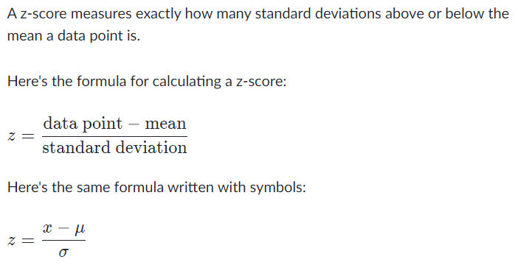
Probability Distributions – Normal Distribution
The normal distribution is a statistician’s workhorse. This distribution is the foundation for many types of inferential statistics that we rely on today. Some examples of continuous random variables are weight, distance, speed, or time.
We can make the following observations about the normal distribution:
The mean, median, and mode are the same value
The distribution is bell-shaped and symmetrical around the mean.
The total area under the curve is equal to 1.
The left and right sides of the normal probability distribution extend indefinitely, never quite touching the horizontal axis.
A positive z-score says the data point is above average.
A negative z-score says the data point is below average.
A z-score close to 000 says the data point is close to average.
A data point can be considered unusual if its z-score is above 3 or below -3.

Slide 11
Sampling
Random sampling refers to a sampling procedure where every member in the population has a chance of being selected.
A biased sample is a sample that does not represent the intended population and can lead to distorted findings
A cluster sample is a simple random sample of groups, or clusters, of the population. Each member of the chosen clusters would be part of the final sample. example- classes in a college are clusters
A stratified sample is obtained by dividing the population into mutually exclusive groups, or strata, and randomly sampling from each of these groups. Examples of criteria that we can use to divide the population into strata are age, income, or occupation.
Sampling error occurs when the sample measurement is different from the population measurement. It is the result of selecting a sample that is not a perfect match to the entire population.

Slide 12
Confidence Intervals
One of the most important roles that statistics plays in today’s world is to gather information from a sample and use that information to make a statement about the population from which it was chosen.
We are using the sample as an estimate for the population. But just how good of an estimate is the sample providing us? The concept of confidence intervals will provide us with that answer.
In applied machine learning, we may wish to use confidence intervals in the presentation of the skill of a predictive model which could be stated as
Given the sample, there is a 95% likelihood that the range x to y covers the true model accuracy.
The choice of 95% confidence is very common in presenting confidence intervals, although other less common values are used, such as 90% and 99.7%.

Slide 13
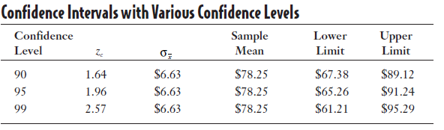
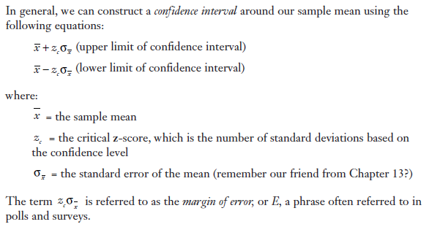
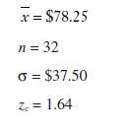
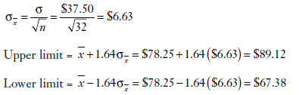
Confidence Intervals – for sample size >30
Let’s say from a sample of 32 customers the average order is $78.25 and the population standard deviation is $37.50. (This represents the variation among orders within the population.). The SD of the sample can be used if population SD is not known
Put simply, the standard error of the sample mean is an estimate of how far the sample mean is likely to be from the population mean
We can reduce standard error by increasing the sample size.
Problem statement : Where does the population mean lie (lower and upper limits) if 90% is the confidence level?

Slide 14
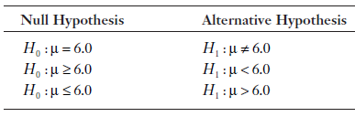
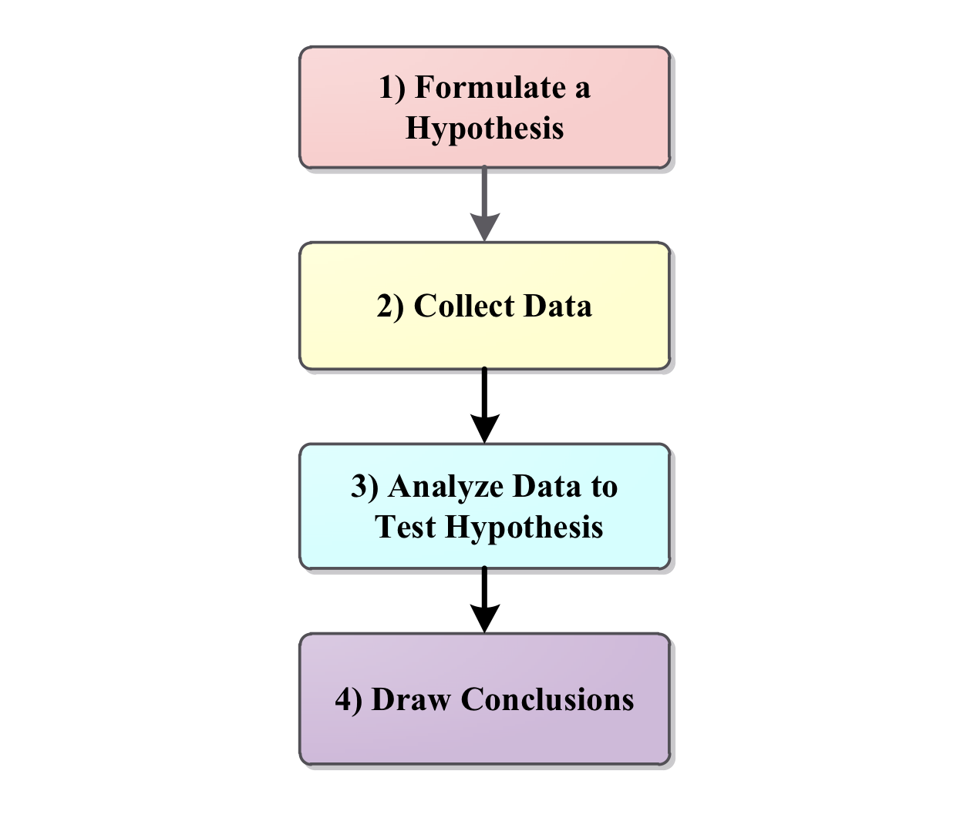
Hypothesis testing
In the statistical world, a hypothesis is an assumption about a population parameter.
The average adult drinks 1.7 cups of coffee per day.
No more than 2 percent of our products sold to customers are defective.
In each case, we have made a statement about the population that may or may not be true. The purpose of hypothesis testing is to make a statistical conclusion about accepting or not accepting such statements.
The null hypothesis, denoted by H0, represents the status quo The null hypothesis is believed to be true unless there is overwhelming evidence to the contrary.
The alternative hypothesis, denoted by H1, represents the opposite of the null hypothesis. Null hypothesis holds true if the H1 hypothesis cant be proved correct.
A one-tail hypothesis test involves the alternative hypothesis being stated as < or >.
A two-tail hypothesis test is used when the alternative hypothesis is expressed as !=

Slide 15
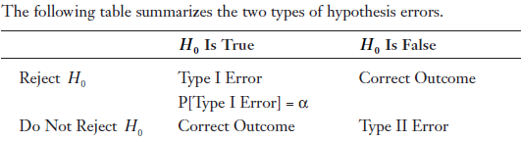
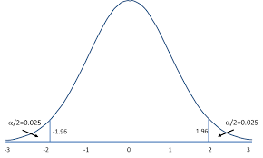
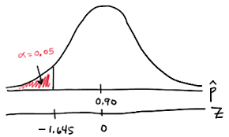
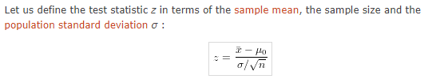
Hypothesis testing
Normally, with hypothesis testing, we decide on a value for alpha that is somewhere between 0.01 and 0.10 before we collect the sample.
If your p value is less than the chosen significance level (lower tail) then you reject the null hypothesis i.e. accept that your sample gives reasonable evidence to support the alternative hypothesis.
The t distribution, also known as the Student’s t-distribution, is a type of probability distribution that is similar to the normal distribution with its bell shape but has heavier tails. T distributions have a greater chance for extreme values than normal distributions, hence the fatter tails.

Slide 16

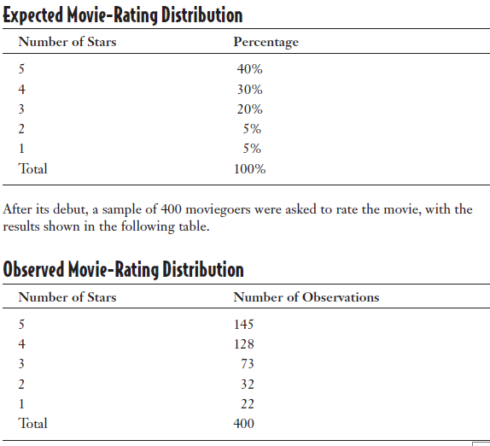
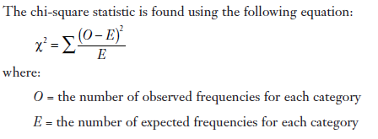
Chi-square distribution – Goodness of fit
The chi-square distribution will allow us to perform hypothesis testing on nominal and ordinal data.
One of the many uses of the chi-square distribution is to perform a goodness-of-fit test, which uses a sample to test whether a frequency distribution fits the predicted distribution. No –ve values.
The total number of expected (E) frequencies must be equal to the total number of observed (O) frequencies.

Slide 17
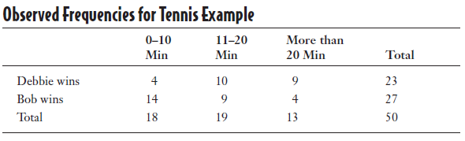
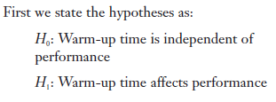
Chi-square distribution – Test for independence
In addition to the goodness-of-fit test, the chi-square distribution can also test for independence between variables.

Slide 18
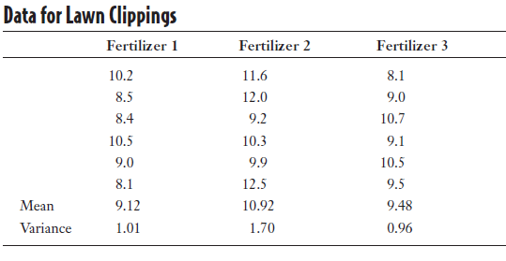

ANOVA, f-test
The F-Distribution is also called as Variance Ratio Distribution as it usually defines the ratio of the variances of the two normally distributed populations. The F-distribution got its name after the name of R.A. Fisher. It can’t be negative
If you want to compare the means for three or more populations part of F-distribution, ANOVA (Analysis of variance)
To use one-way ANOVA, the following conditions must be present:
The populations of interest must be normally distributed.
The samples must be independent of each other.
Each population must have the same variance.
The simplest type of ANOVA is known as completely randomized one-way ANOVA, which involves an independent random selection of observations for each level of one factor. – f-test

Slide 19
Thank You

